Slide 1
Bi-weekly project updates
09/06/2018

Slide 2
Future Plans in previous report
Fine-tune the overall project framework;
OCR-based analysis:
Design a better image downloading pipeline;
Investigating and improving similarity analysis;
“Key-word” learning
Image based analysis:
Implement Siamese architecture
Try conducting training dataset

Slide 3
Outlines
Before we started:
At the beginning stage of this project, we will focus on data curation and pre-processing for the next few weeks. Besides, we would brainstorm feasible pipelines and fine-tune them based on pilot study.
Data curation and pre-processing:
Ground-truth (GT): drug package label obtained from DailyMed
Public dataset (PD) : Data downloaded from Google image search

Slide 4
Ground-truth (GT)
drug package label obtained from DailyMed

Slide 5
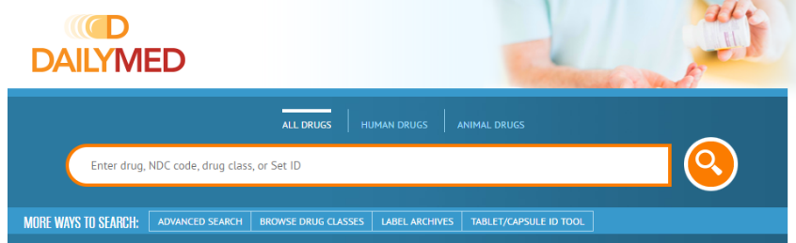
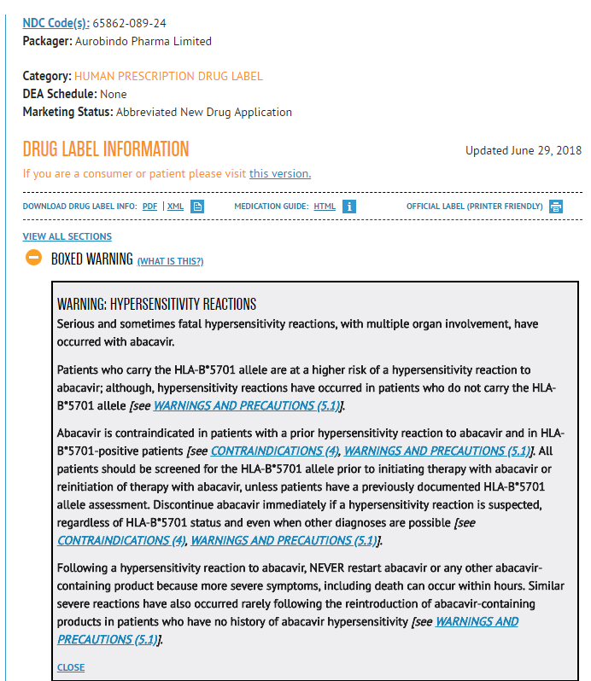
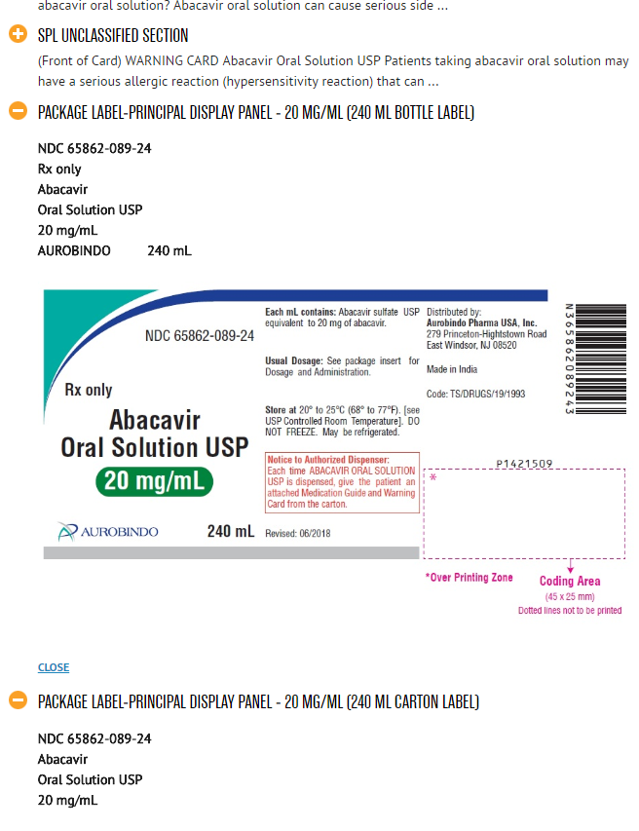
GT Data overview
abacavir
… …
This is what we need

Slide 6
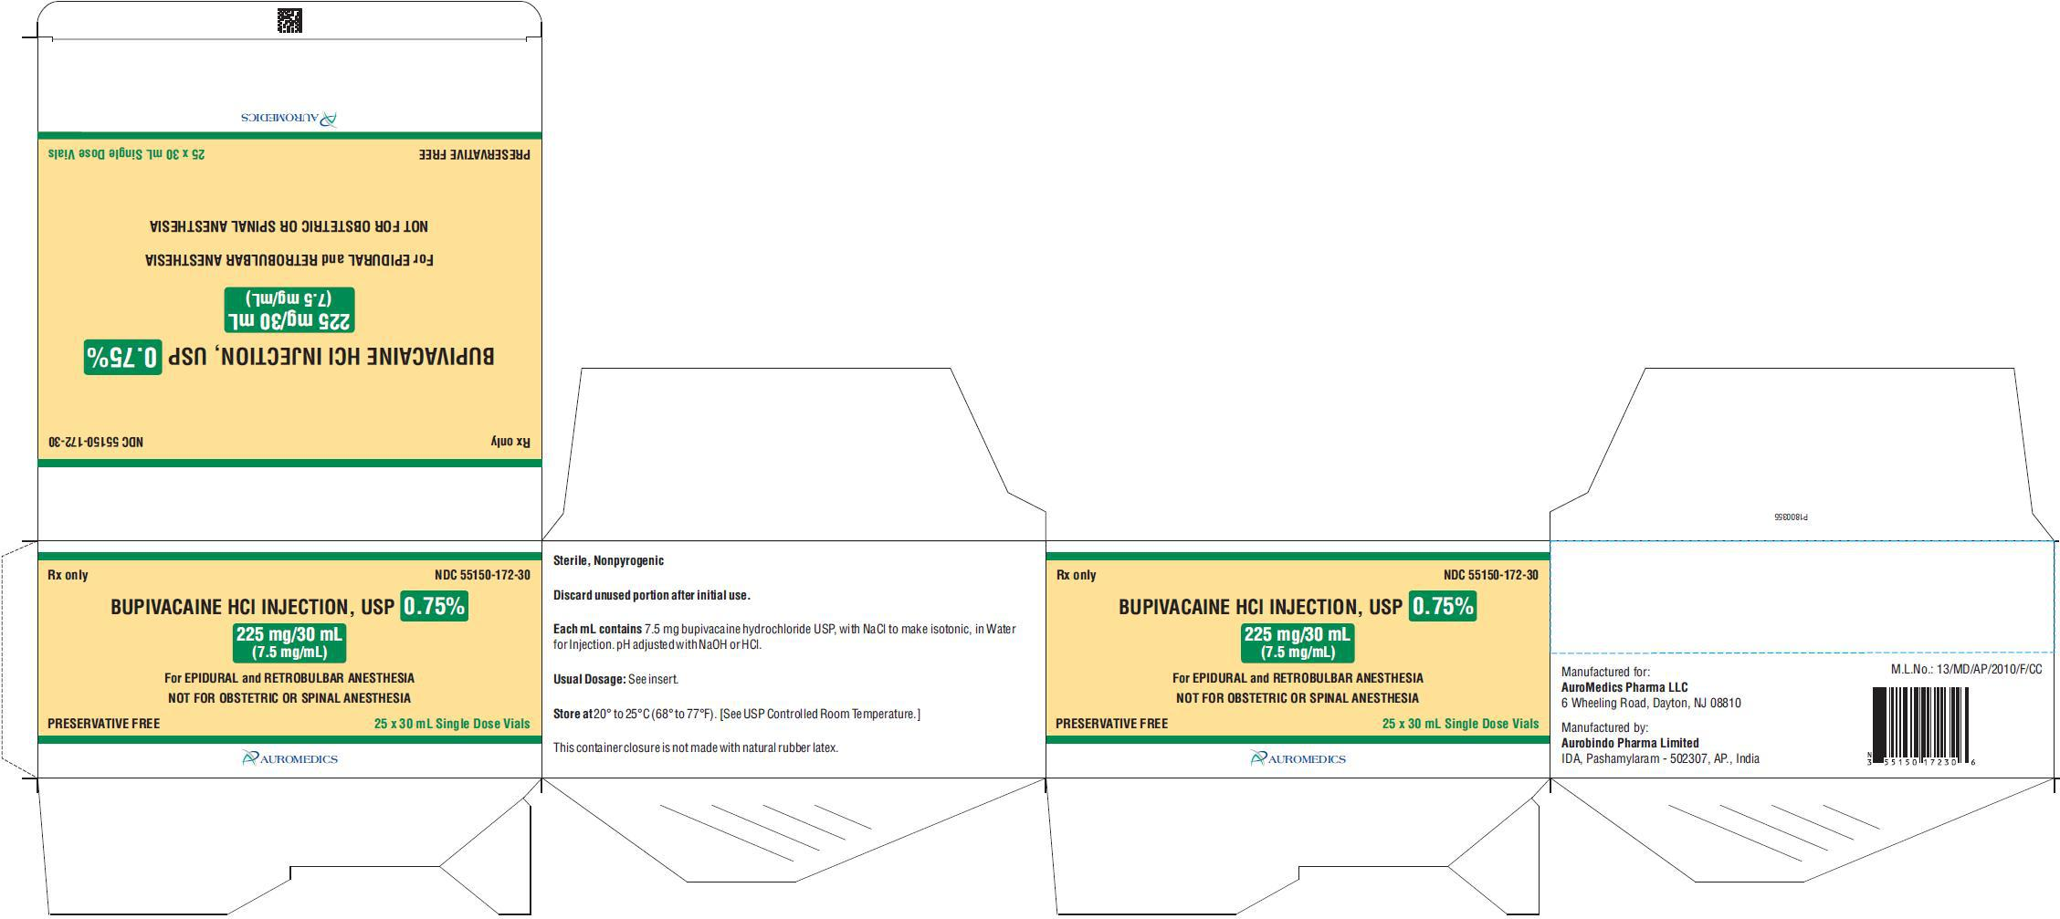
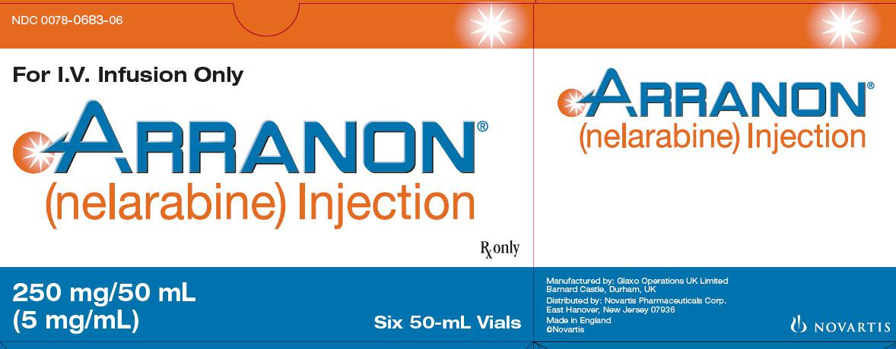
GT data retrieving
Let’s do something with text-mining …
DailyMed_dataset_show.html
Download 36,983 prescription drugs (due to 08/28/2018) from DailyMed
Parse information from SPL documents (in XML format)
35,888 includes at least one package label
Over 58,000 images (~75G data)
<code code="51945-4" codeSystem="2.16.840.1.113883.6.1" displayName="PACKAGE LABEL.PRINCIPAL DISPLAY PANEL"/>
Example Image
Example Image
Example Image

Slide 7
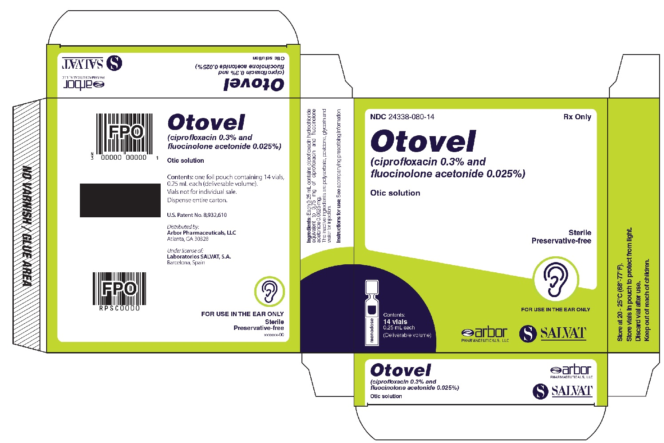
Extra drug information via labeling
SET_ID: 1a7e4806-3138-4b7a-b798-a99e163ee846
SPL_ID | SPL_GUID | PRODUCT_TITLE | SPL_MD5 | DOCUMENT_TYPE_LOINC_CODE
206460 | 736bbfd0-1fbd-4615-80f6-3f5f1ae12284 | These highlights do not include all the information needed to use OTOVEL safely and effectively. See full prescribing information for OTOVEL. / / OTOVEL (ciprofloxacin and fluocinolone acetonide) otic solution / Initial U.S. Approval: 2016 | 53cf2127c6eb26b16cd8e94b26c1f4c4 | 34391-3
DOCUMENT_TYPE | AUTHOR_ORG_NORMD_NAME | NUM_PRODUCTS | NUM_GENERIC_PRODUCTS | MARKETING_ACTS
HUMAN PRESCRIPTION DRUG LABEL | ARBOR PHARMACEUTICALS | 1 | 1 | 2016/04/29-
PRODUCT_NAMES | PRODUCT_NORMD_GENERIC_NAMES | MARKET_CATEGORIES | ROUTES_OF_ADMINISTRATION | NDC_CODES
OTOVEL | (CIPROFLOXACIN AND FLUOCINOLONE ACETONIDE) | NDA | AURICULAR (OTIC) | 24338-080
DOSAGE_FORMS | NUM_ACT_INGRS | ACT_INGR_UNIIS | ACT_INGR_NAMES | DAILYMED_NDC_LINKS
FOR SOLUTION | 3 | 0CD5FD6S2M; 5E8K9I0O4U; 6OZP39ZG8H | ciprofloxacin; fluocinolone acetonide; polysorbate 80 | http://dailymed.nlm.nih.gov/dailymed/lookup.cfm?ndc=24338-080
ARCHIVE_DIR | FILENAME | EFF_TIME | VERSION_NUM | ARCHIVE_DIR_DATE
20160518_1a7e4806-3138-4b7a-b798-a99e163ee846 | 736bbfd0-1fbd-4615-80f6-3f5f1ae12284.xml | 20160429 | 1 | 20160518
ORG_CURRENCY_RANK | INITIAL_APPROVAL_YEAR | REVISED_DATE | EPC | And Even More ..
8 | 2016 | April 2016 | Corticosteroid; Quinolone Antimicrobial | Based on further requests ...

Slide 8
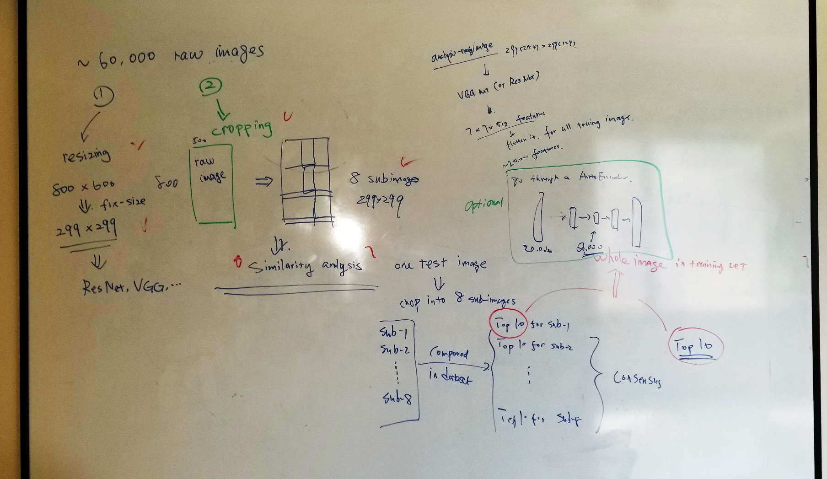
Image preprocessing (brainstorming)

Slide 9
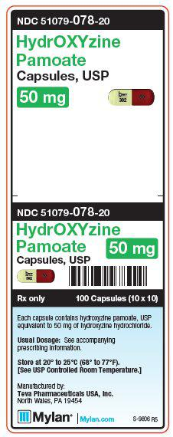
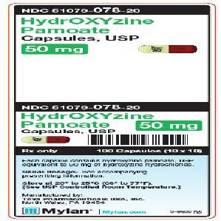
Image pre-processing: Resizing
*why resize to 299*299?
299*299 is the input size of ResNet architecture, where for VGG network architecture the input size is 224*224; we picked the larger one to make sure the image information kept the most during the potential following analysis.
*Note that the resizing size may change in the future; or we may discard resizing approach at all.
resize
299*299

Slide 10
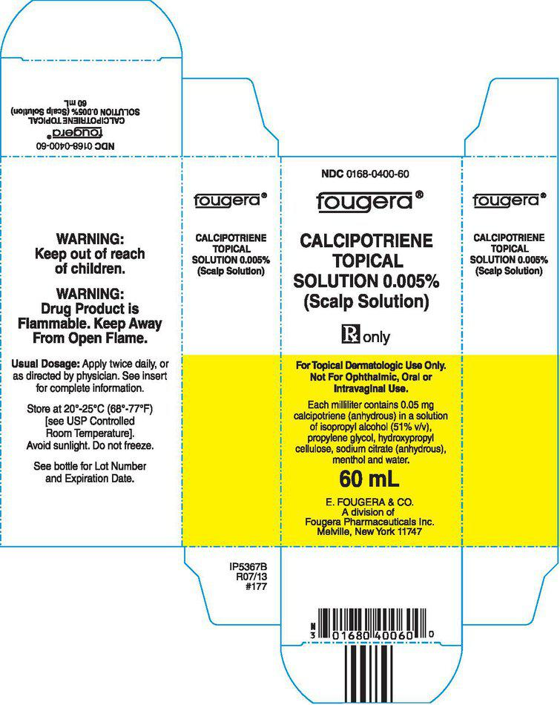
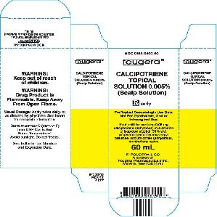
Image pre-processing
resize
299*299

Slide 11
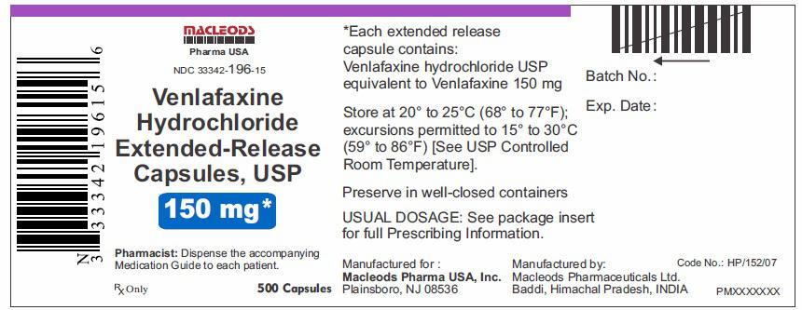
Cropping approach
Raw drug label primary display panel Image

Slide 12
Cropping approach
1
2
3
4
5
6
7
8

Slide 13
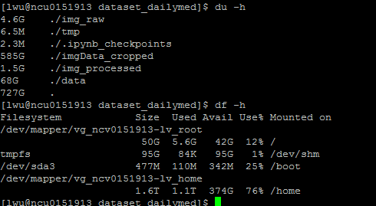
Cropping approach (examples)
cropping_image_show.html
cropping_image_show (2).html
Total cropped data size: 585G (~67,000 npz files)
Short of storage space in the workstation right now
- (only 350G/1.6T free disk space)

Slide 14
Public Dataset (PD)
Data downloaded from Google image search

Slide 15
Image downloading and processing
Download image by designed keywords
(drug name + other restricted words)
Followed by the developed similarity analysis pipeline

Slide 16
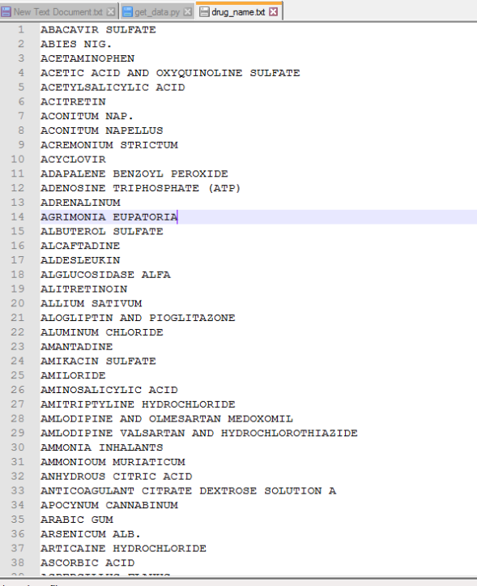
Drug list
Currently, ~430 drugs (all human prescription drugs) are in the list.
The whole list may change by considering GT studies.
13 drugs are selected in the pilot study.
Original data resources: FDALabel database
select distinct substance_name from dgv_prod_ingr dpi
join dgv_sum_spl l on l.spl_id = dpi.spl_id
where l.document_type_loinc_code = '34391-3'
and dpi.is_active = '1';
*further fine-tuning processing are applied.

Slide 17
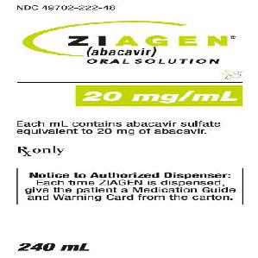
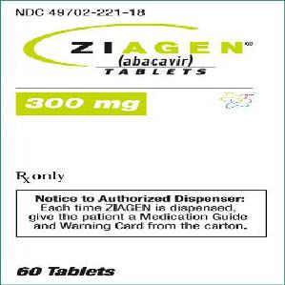
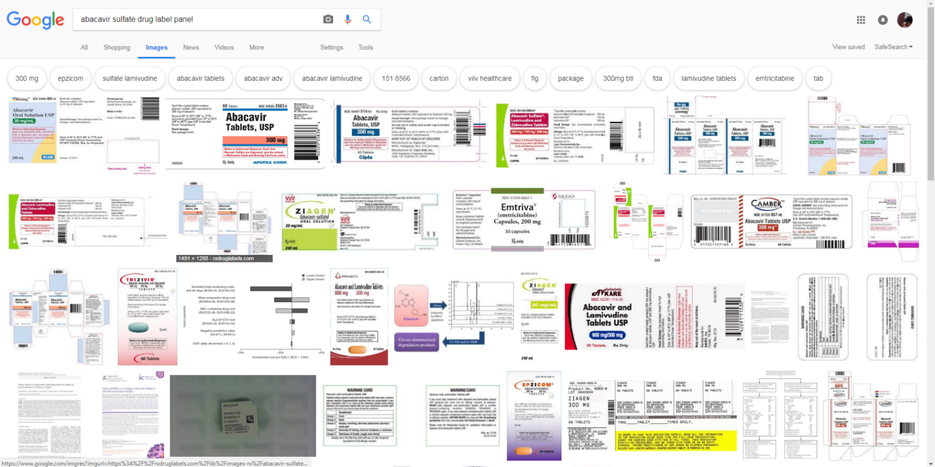
Google image search (manual)
Ground truth for Ziagen in GT dataset
This is a typical negative (unrelated) image

Slide 18
Pilot result
Data pre-processing
Exclude drug unrelated images
Remove samples with text less than 10 chars
Remove samples has text more than 200 chars
Finally 104 images left
Similarity analysis approach 1:
Rank and get top 5 results has highest similarity score for each image
Measure the accuracy (whether under the same folder/category)

Slide 19
Accuracy of top 5 score results
Details are displayed in following slides

Slide 20
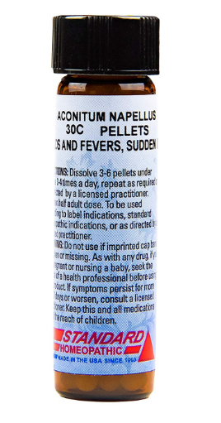
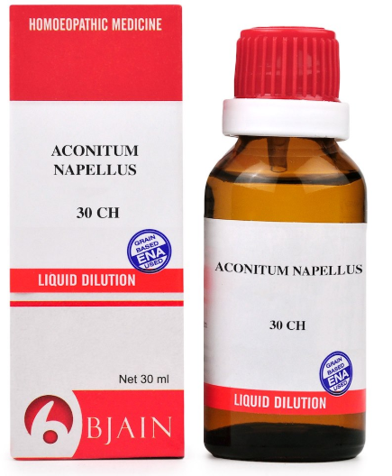
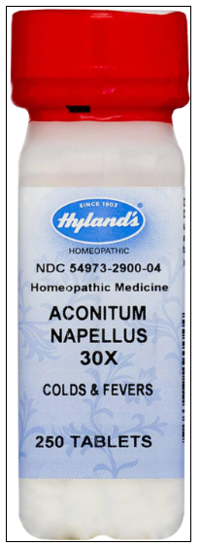
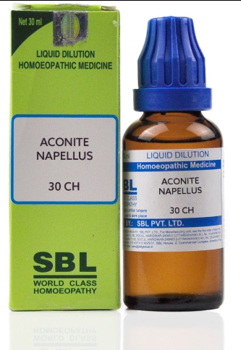
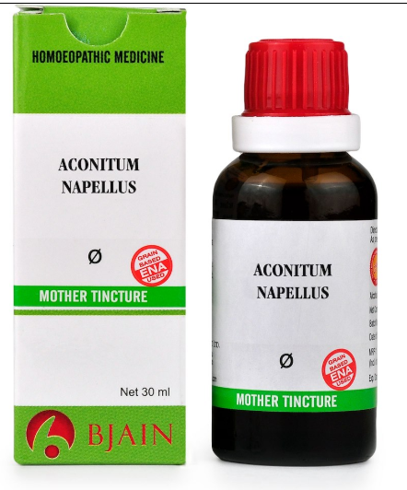
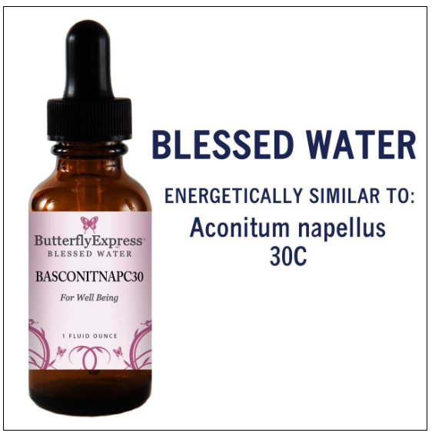
Example: Aconitum Napellus
Score: 85
Score: 85
Score: 77
Score: 73
Test Image
Score: 46
100% accuracy with top 5 candidates

Slide 21
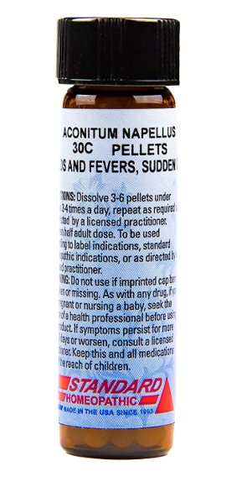
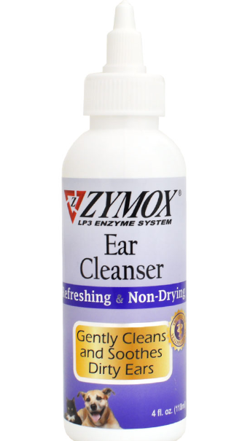
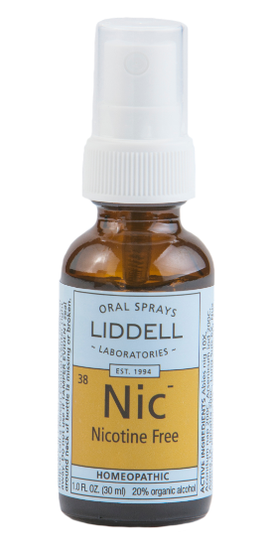
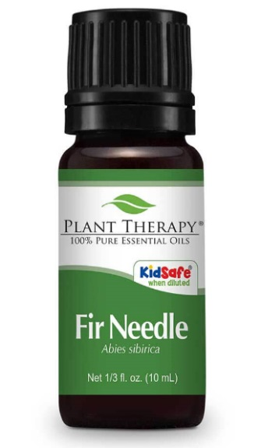
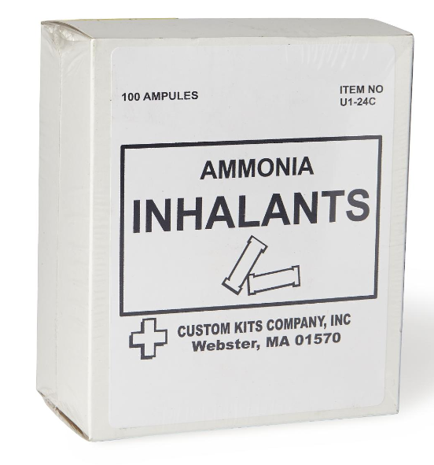
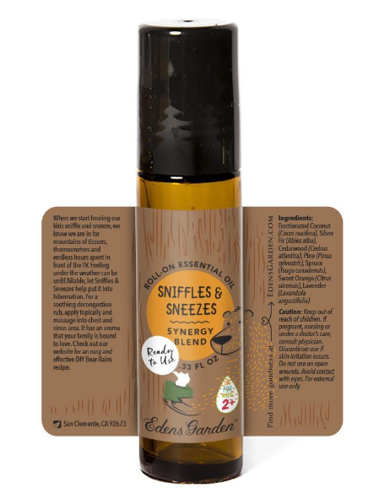
Example: Ammonia Inhalants
Score: 42
Score: 36
Score: 35
Score: 33
Test Image
Score: 33
0% accuracy with top 5 candidates
ITEM NO 100 AMPULES U1-24C CUSTOM KITS COM Webster, MA 01 570
The most important words,
Ammonia inhalants are missing

Slide 22
Summary for PD study
Not all images are correctly predicted:
Improving the OCR model
Improving labeling category (with GT dataset)
Improving the similarity measurement approach
Performance is score relevant:
Corrected sample usually has high similarity score (>60)
Incorrected sample usually has low similarity score (<40)
Considering “key-word” learning

Slide 23
Summary and Next step:
GT:
DailyMed is an enriched resource for our study;
Which image pre-processing way (cropping, resizing) is more appropriate?
How to utilize the drug information define labels?
Other resources?
PD:
Google-image-download is currently the best way.
How to combine with GT study?
Alternative tools?
Others
“Key-word” learning
Improving similarity approach

